Slide 1
Crime Trends in New Orleans between 2018-2022
Todd Petruska, Francesca Palik, Alexandra de Roos, Nandini Tivakaran

Slide 2

Research Questions
How did rates of types of crimes differ across New Orleans districts from 2018 to 2022?
How did the frequency of overall crimes committed change across districts during the specified time period? What was the distribution of genders across the years?
Used police reports from 2018-2022 from data.nola.gov

Slide 3
Cleaning Up the Data
Transformation of the raw data using “Item Number”
How to get rid of duplicates
First occurrence of an “Item Number” vs. all the duplicates
Reports would be edited with follow-up information
Only used first occurrence to gather insight with integrity
How much to data will we lose?

Slide 4
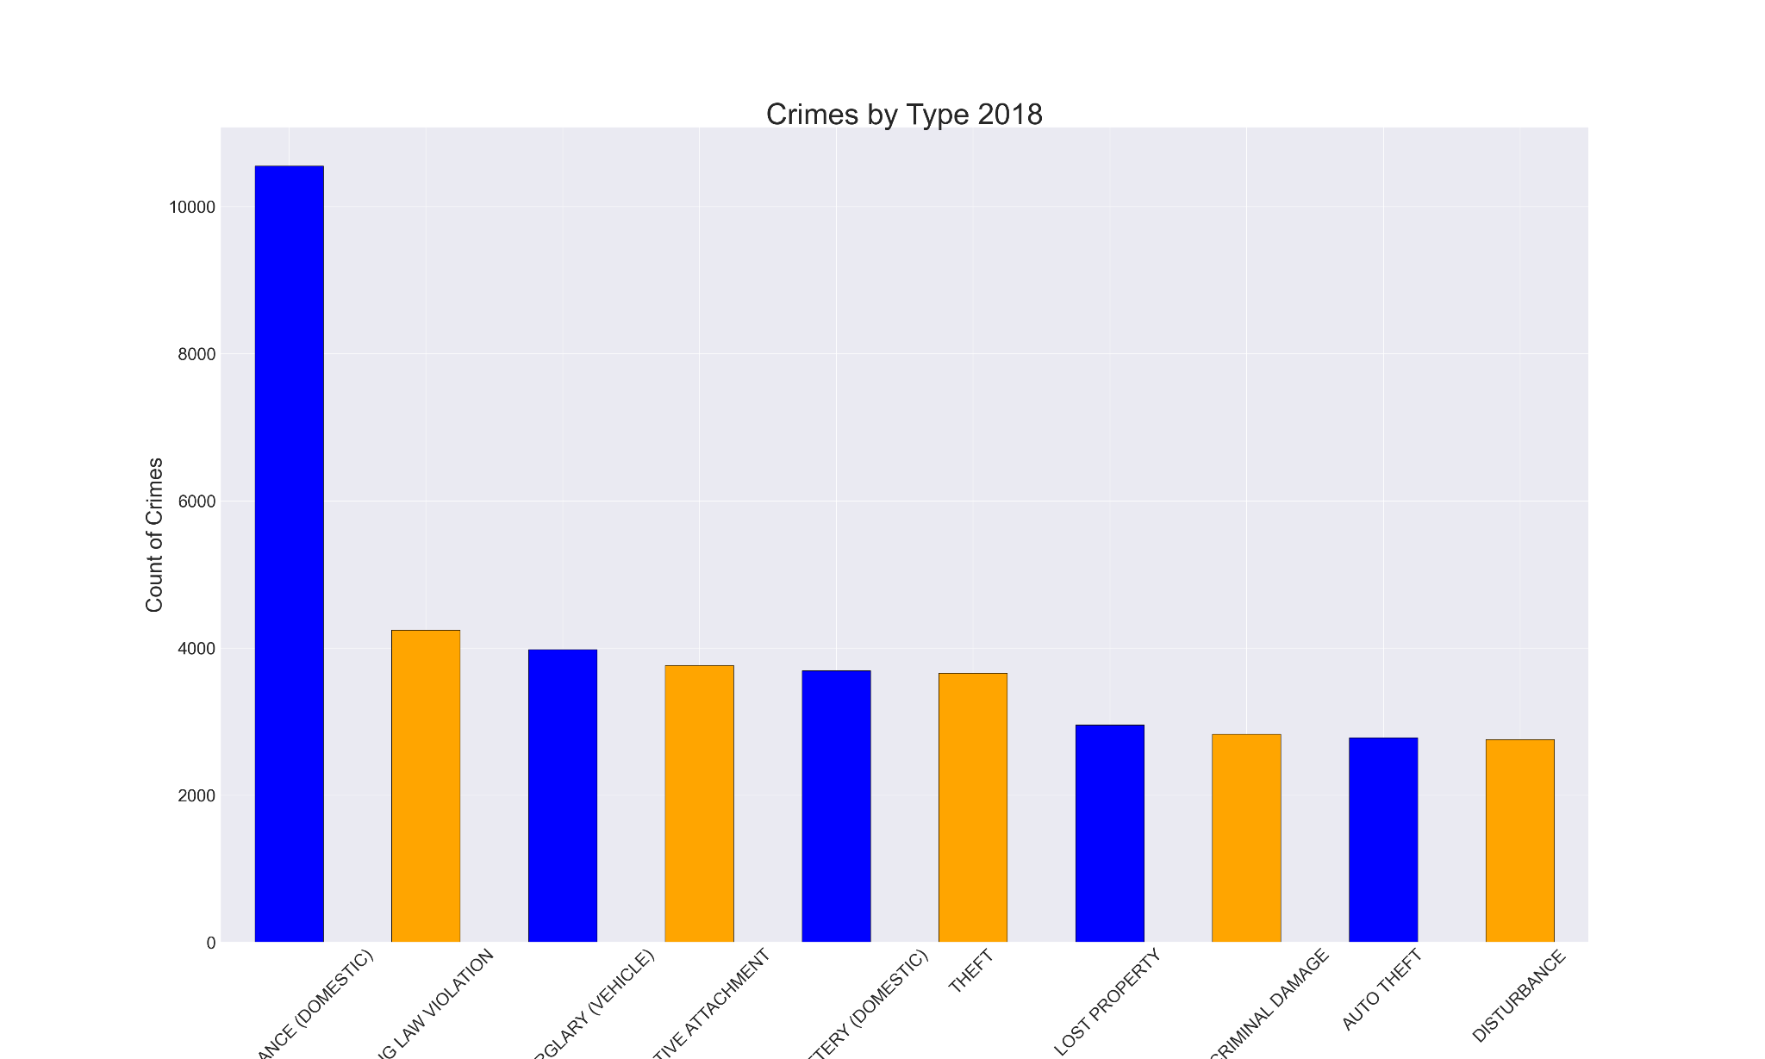
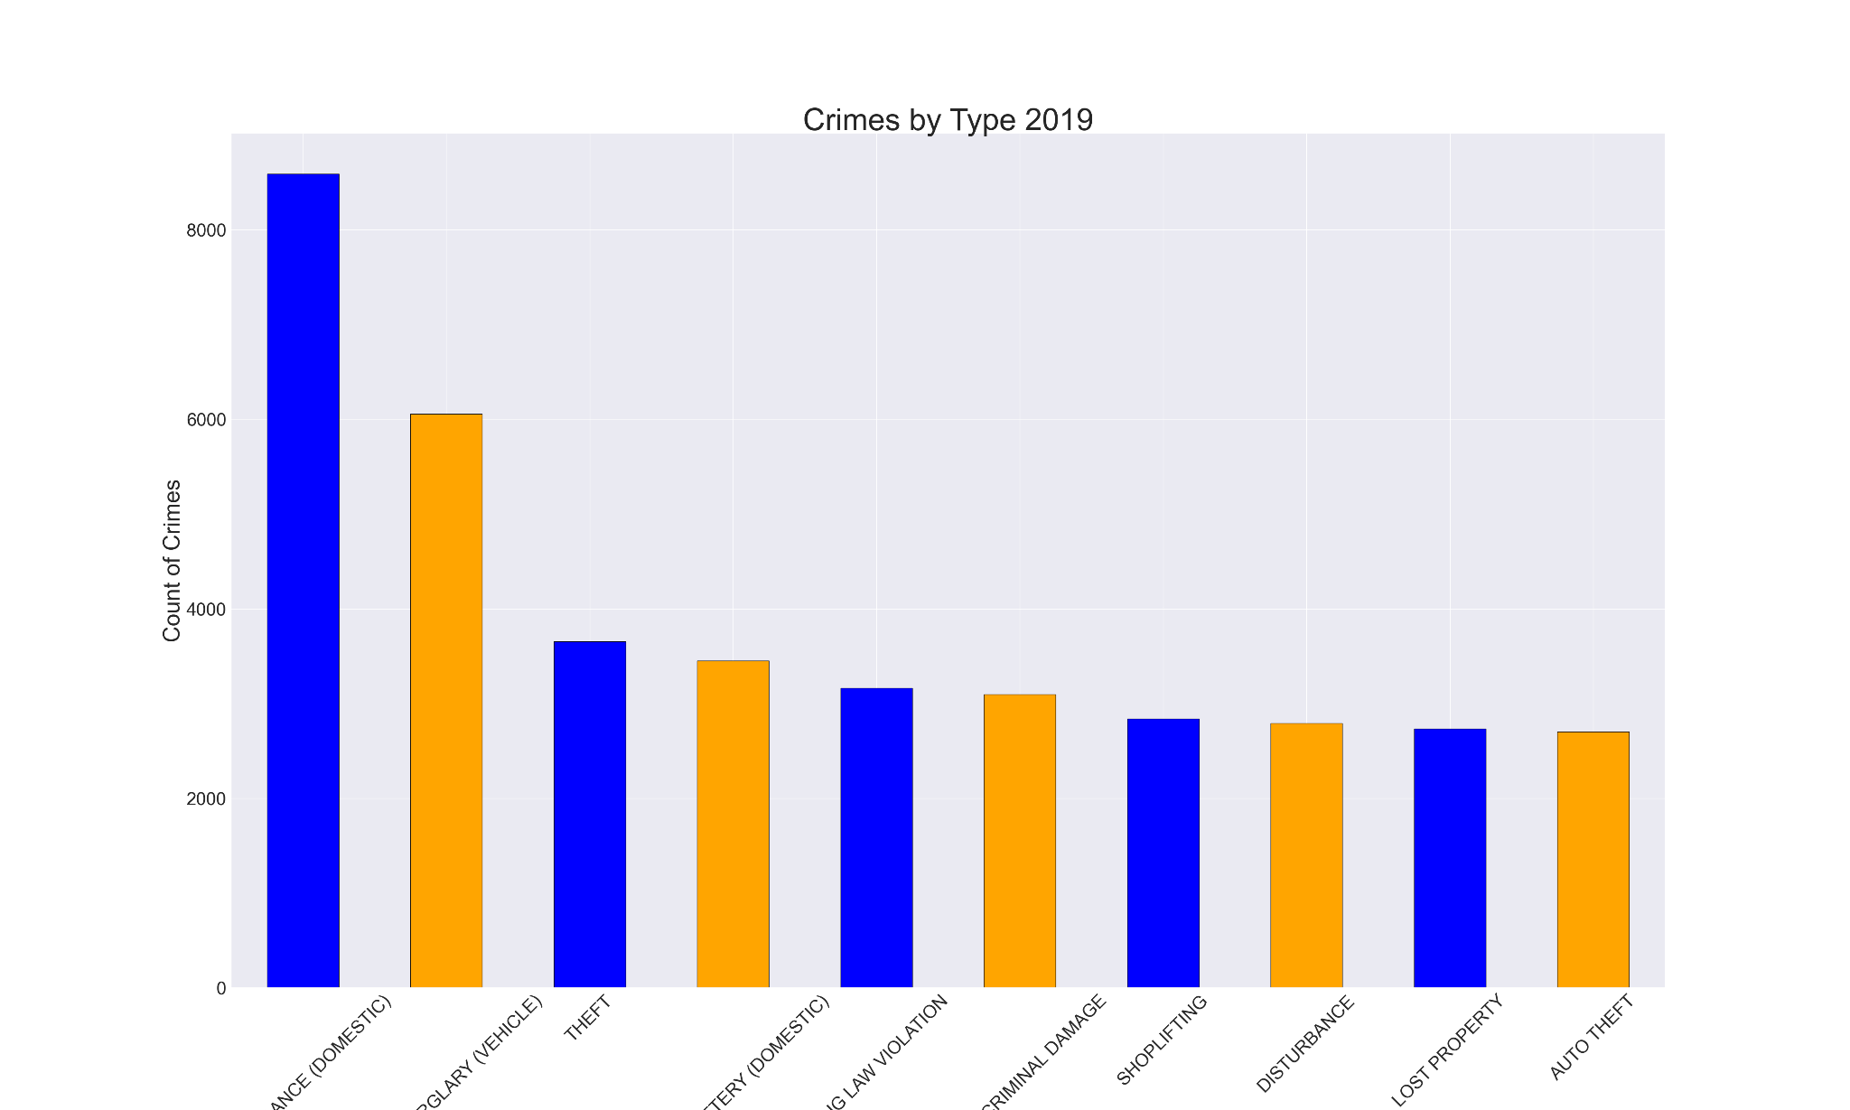
Analysis by Crime Type
Top two crimes: Domestic Disturbance & Vehicle Burglary
Notes:
The top two crimes were domestic disturbance and vehicle burglary in all years except 2018. In 2018, the second highest crime was drug law violation. Vehicle burglary continued to increase until by 2022 it is almost even with domestic disturbance

Slide 5
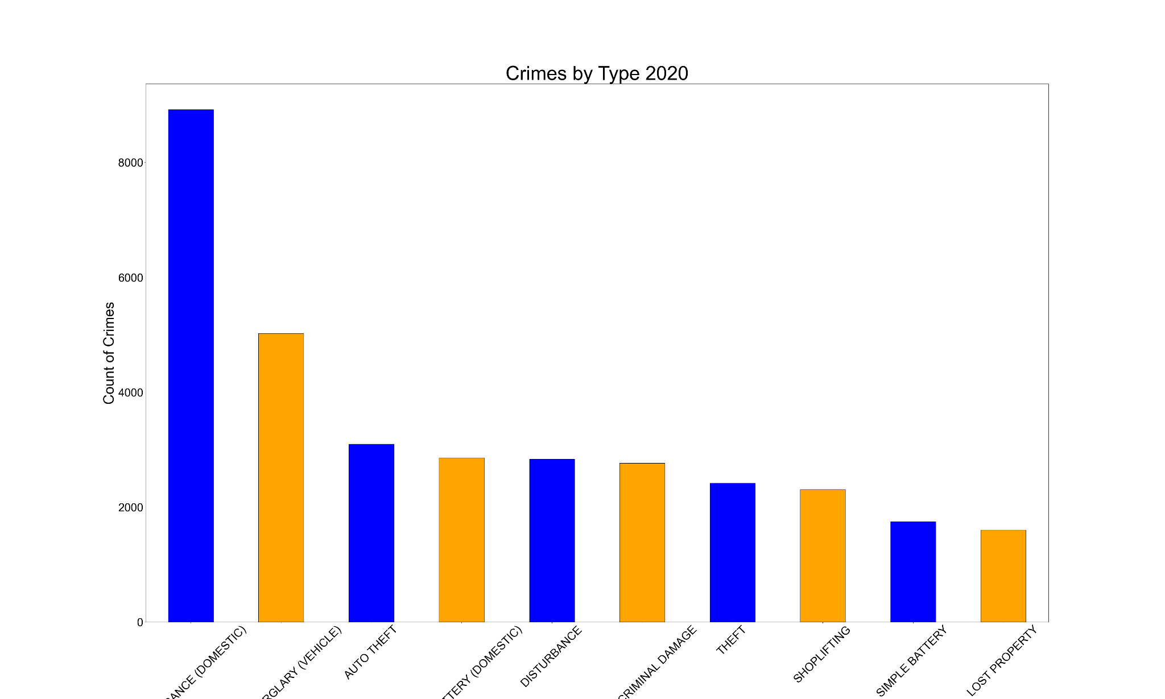
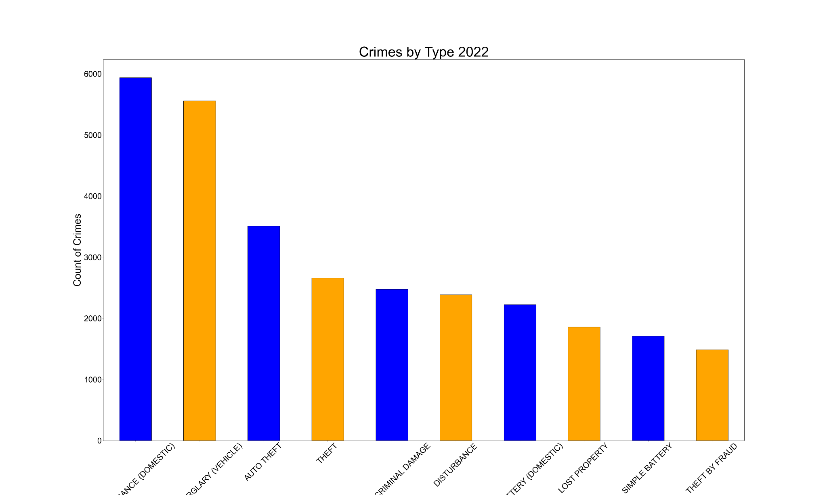
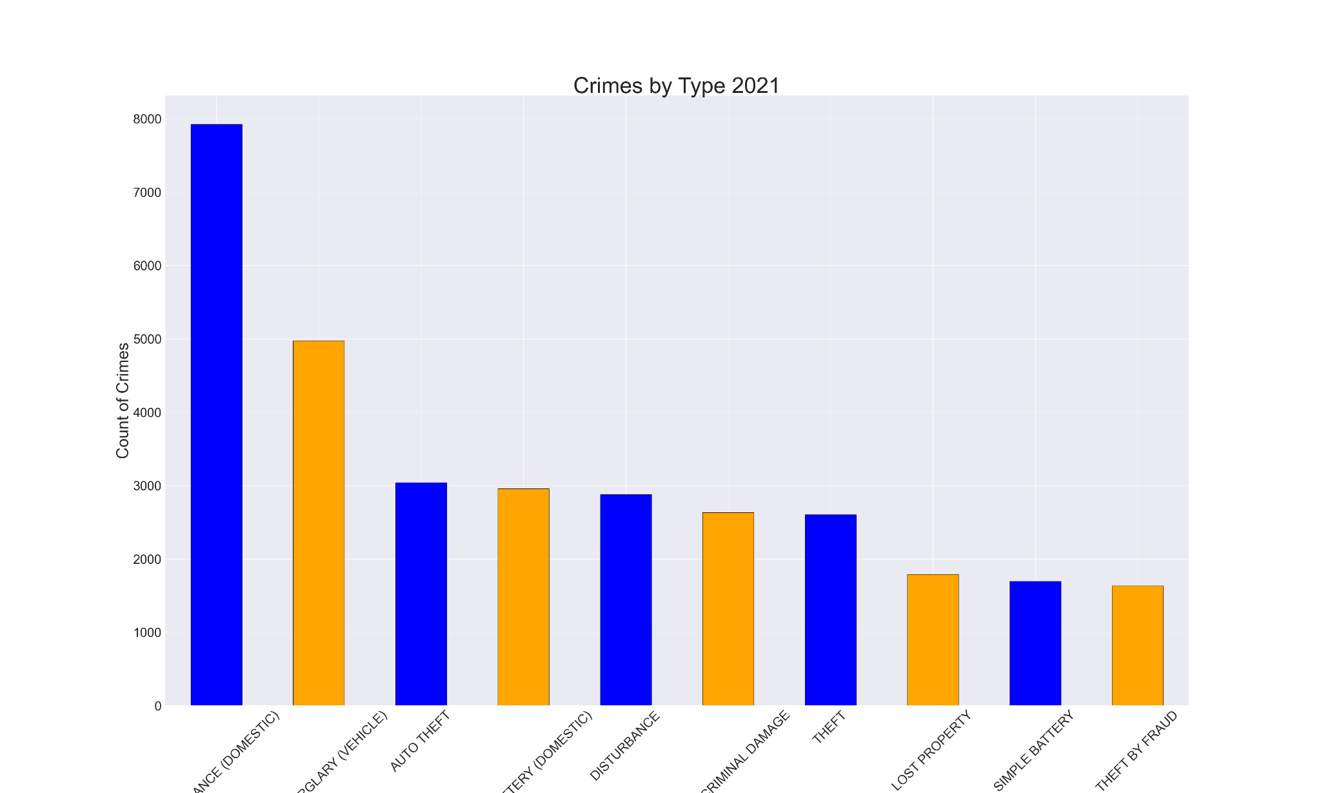
Analysis by Type (part2)

Slide 6
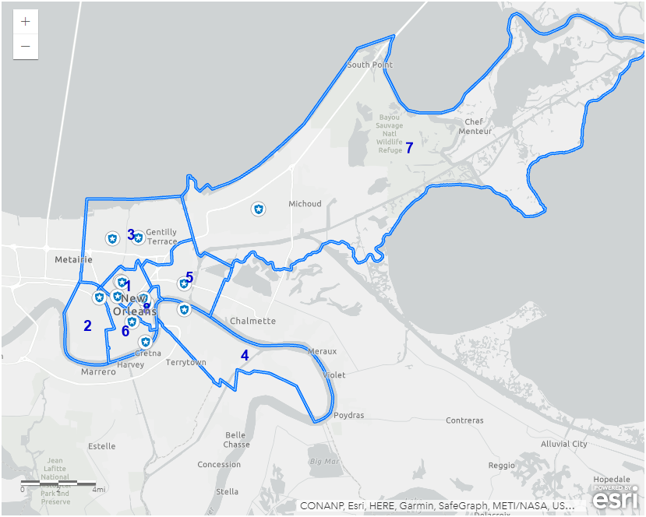
Map of New Orleans Districts
Notes:
New Orleans is split into 8 districts or parishes. This is a map of the districts. We did analysis of frequency of time in each district

Slide 7
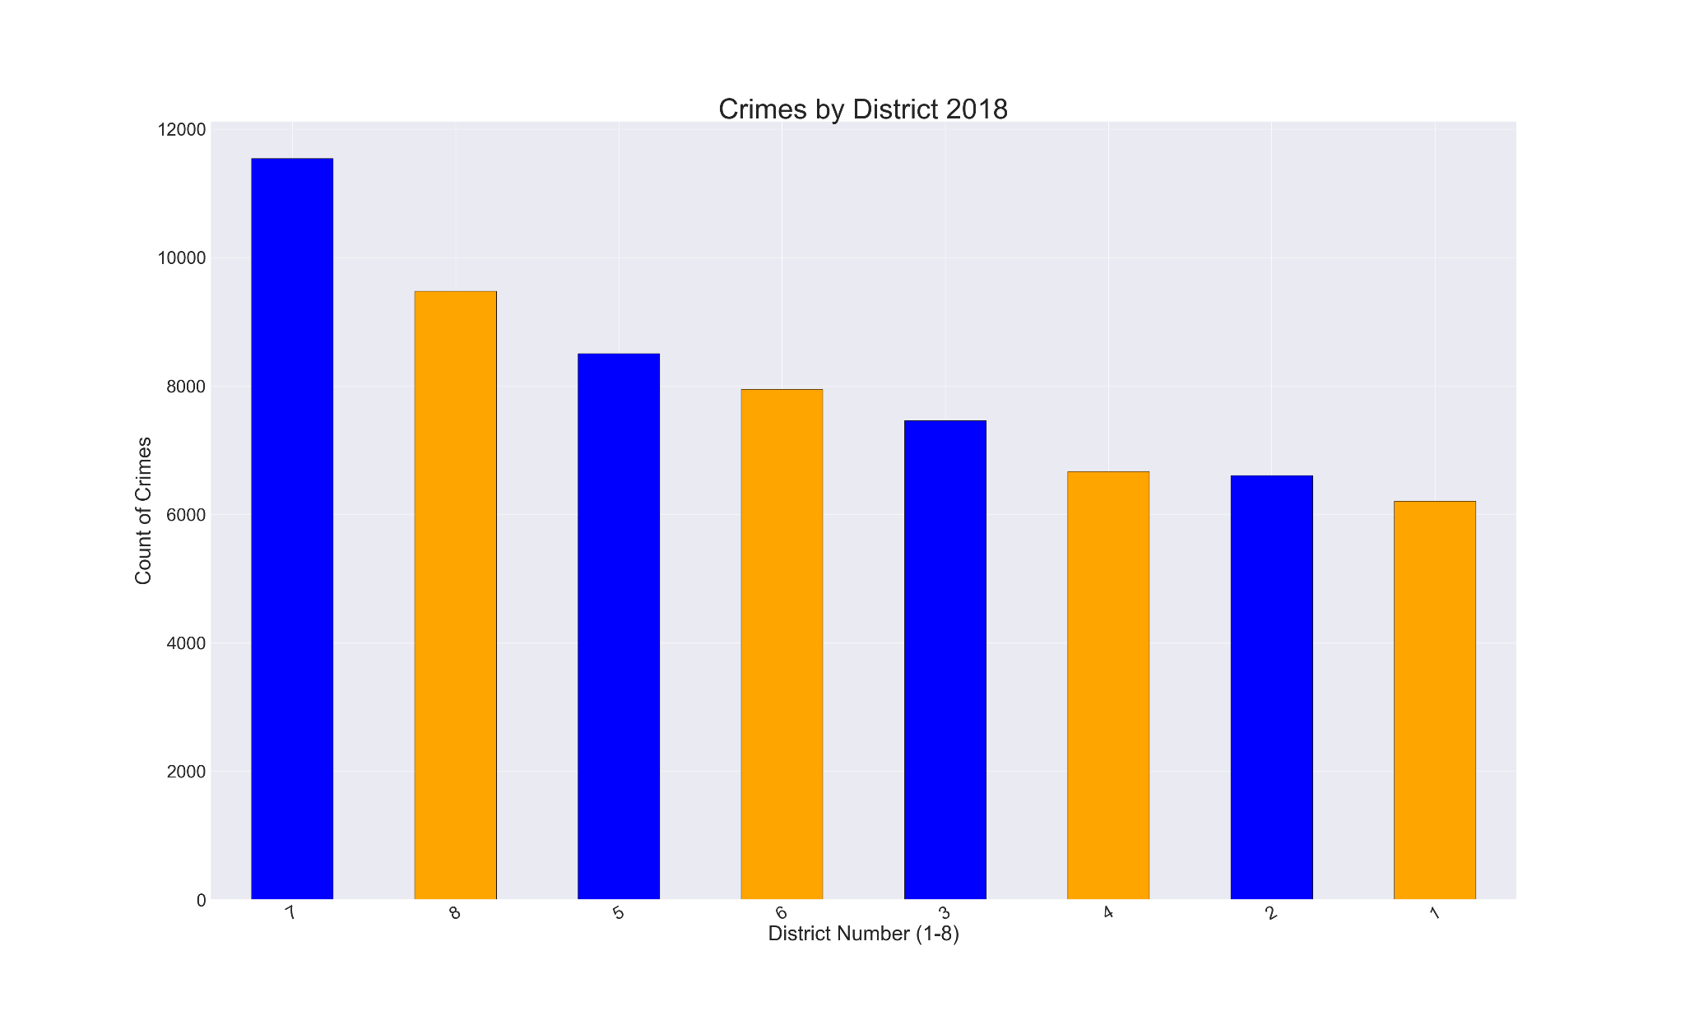
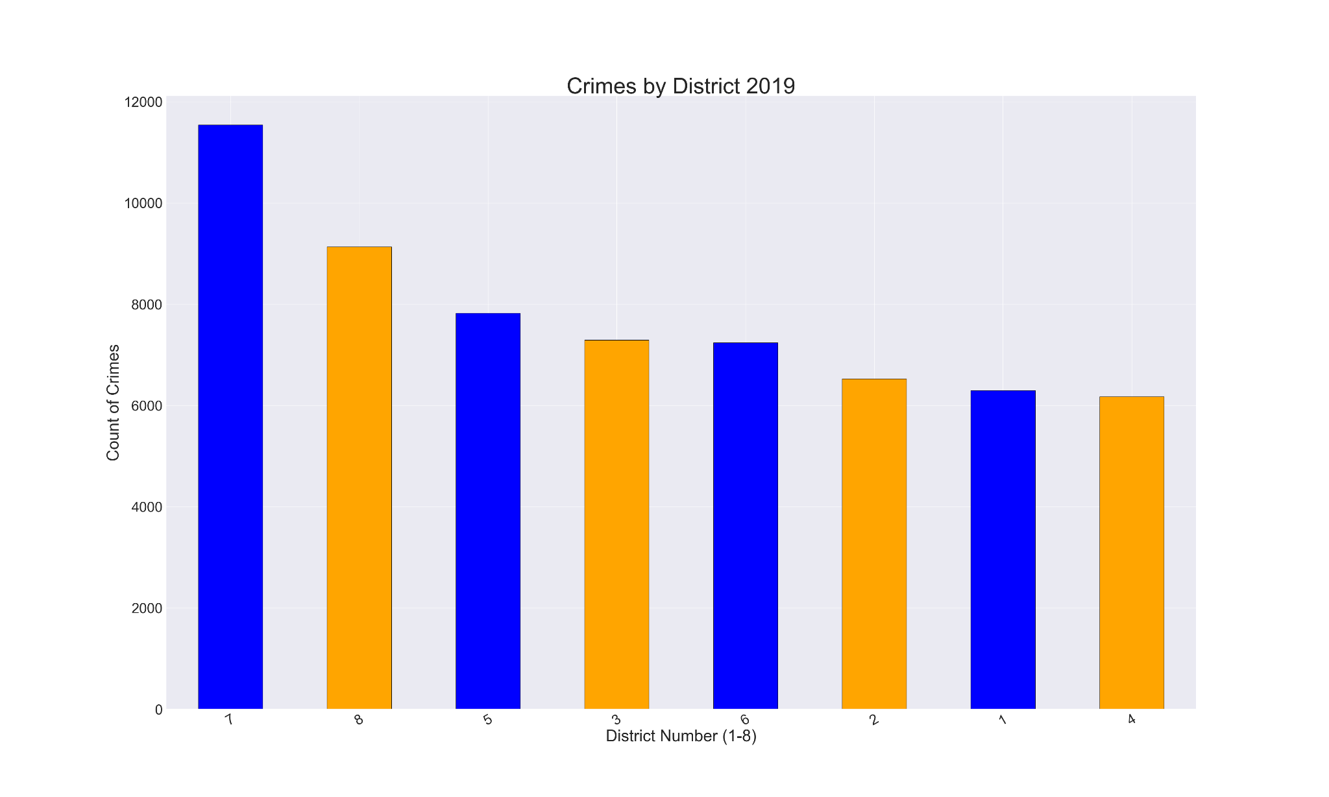
Analysis by District
District 5 increased, District 8 decreased
Notes:
The district with the most crimes is district 7 with district 8 being second and district 5 being third. The proportion of crime increased in District 5 and in 2020 and 2021. District 8 decreased in crimes and by 2022 was had the biggest proportion. The top three districts shuffled around and the rest of the districts stayed relatively the same

Slide 8
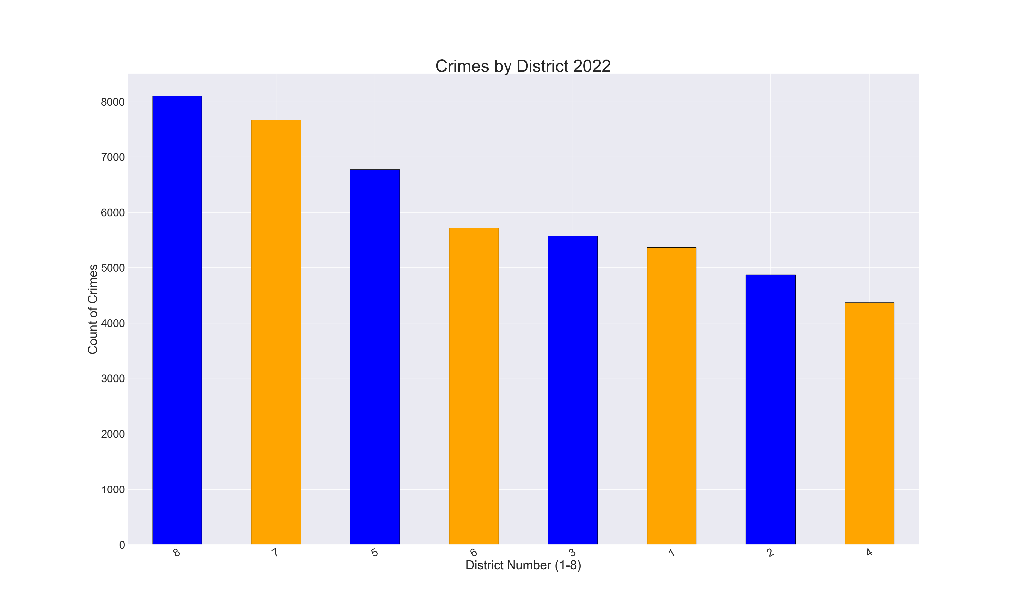
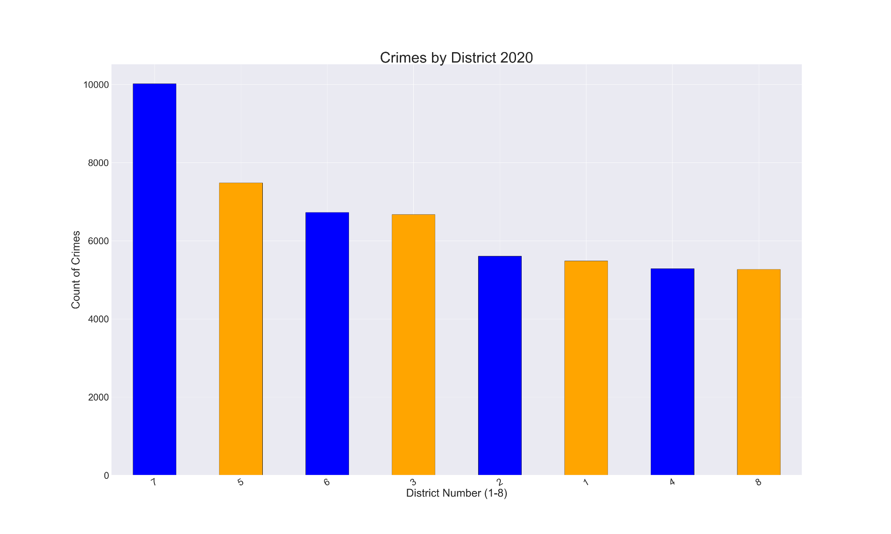
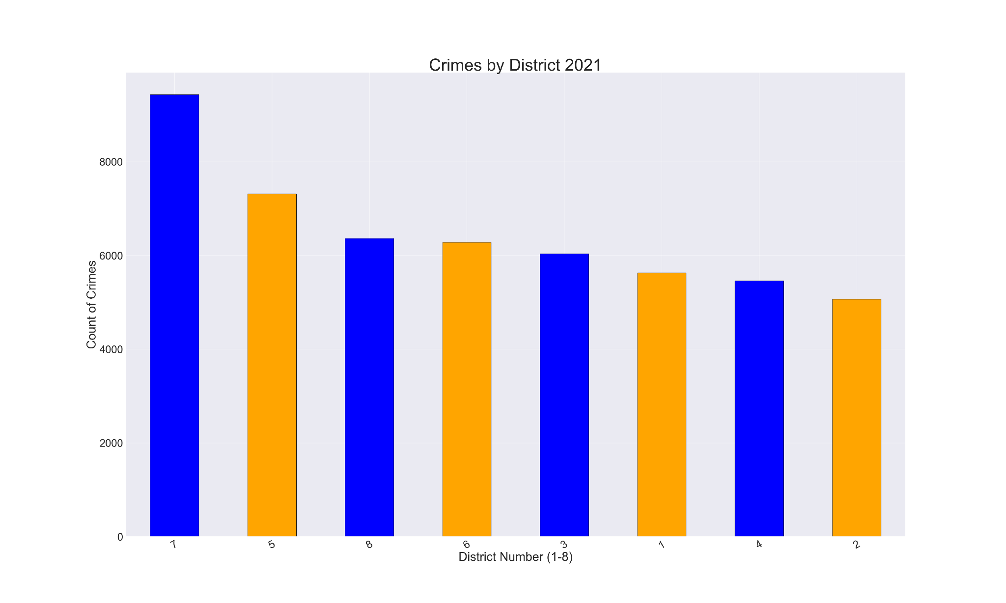
Analysis by District (part 2)

Slide 9
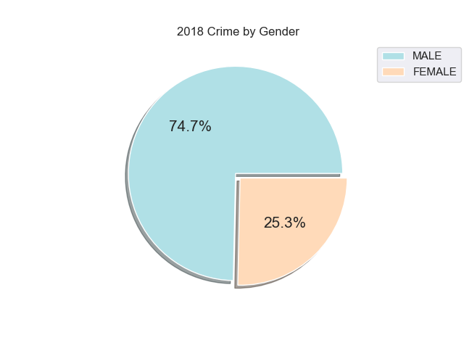
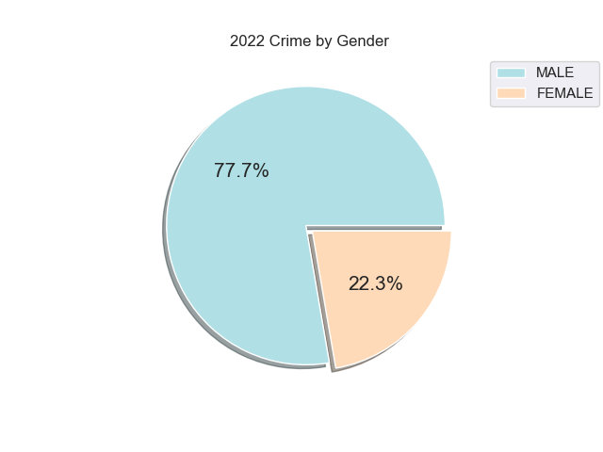
Analysis by Gender
More crimes committed by men
Notes:
Each year more crimes were committed by men.

Slide 10
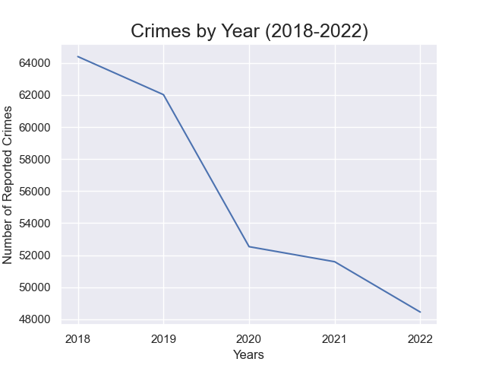
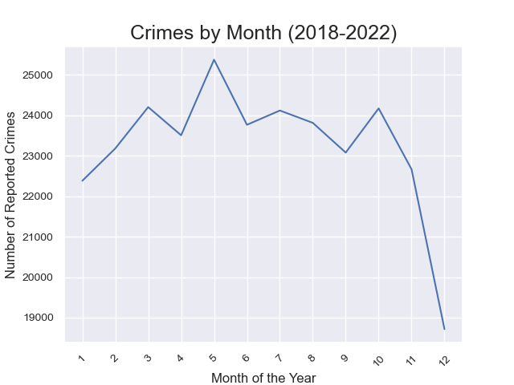
Crimes Types in Time (part 1)
Decrease over time
Notes:
Even though there was an increase in some crime types or in some districts, overall there was a decrease in reported crimes from 2018 to 2022. We noticed that over a year, May had the most reported crimes.

Slide 11
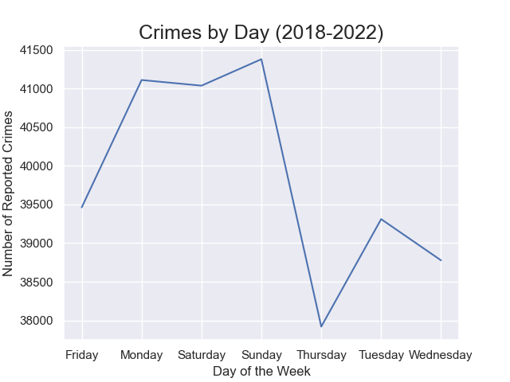
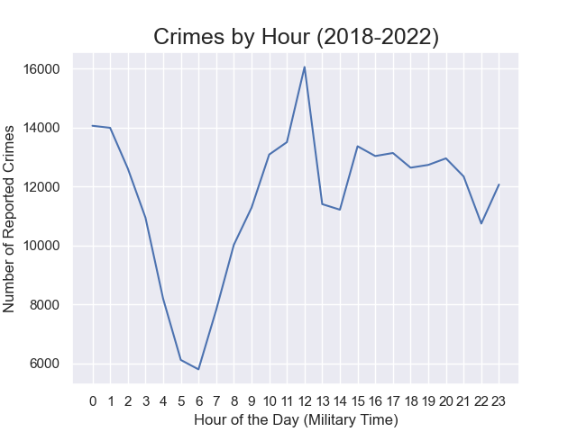
Crimes Types in Time (part 2)
Notes:
We also looked at days of the week and the time of day. Most reported crimes occurred on Sunday and the least reported crimes occurred on Thursday. During a day, most crimes were reported at noon and the least amount of crimes were reported around 6 am.

Slide 12
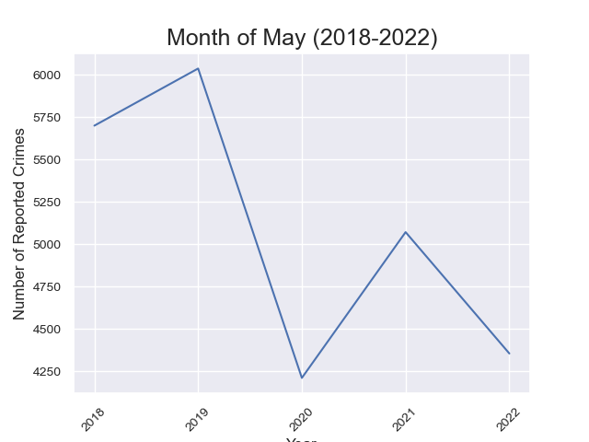
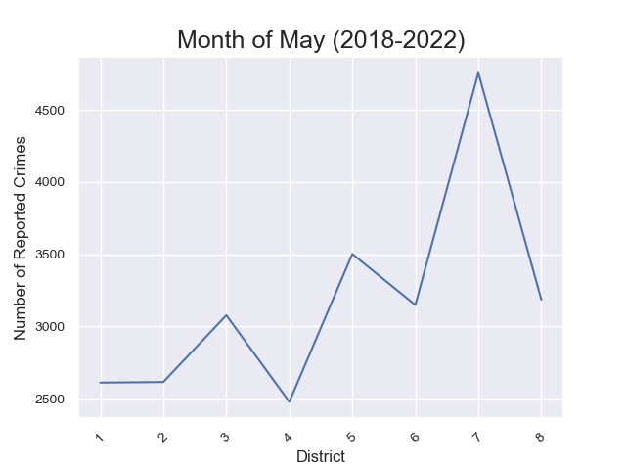
Month of May
Notes:
In terms of the month of May, crime did decrease overtime with the most crimes reported being in 2019. 2020 was the lowest. 2021 and 2022 were lower then pre-pandemic years, but higher then 2020. In the month of May, District 7 had the most crimes reported.

Slide 13
Coding & Statistical Analysis
Methodology
How did we get any of these charts?
Hurdles
What was hard about getting these charts?
Month of May
Statistically important

Slide 14
Future Areas of Exploration
Provide more years from pre-pandemic & post-pandemic
Give a better overview over time
Census or population density per district
How are the districts separated
Historical changes in the districts

Slide 15
Q & A

